Slide 1


CevaXM4 Subsystem in Sirius
Cong Liu
30/11/2007

Slide 2
OutLine
CevaXM4
Block Diagram
Configuration
Register File
Boot
DMA and QMAN
CevaXM4 subsystem in Sirius
Block Diagram
CGU/RGU/Reg
IGU and Multi-core
Multi_Voltage Design

Slide 3
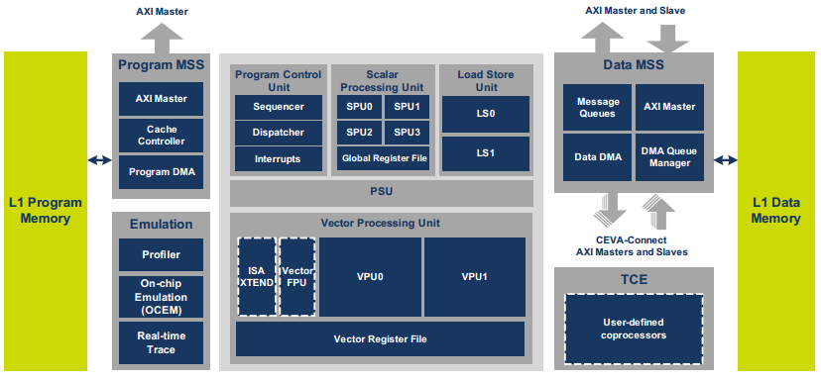
CevaXM4 - Block Diagram
EPP
EDP
EDAP
Core
MSS
OCEM
PTCM
DTCM

Slide 4
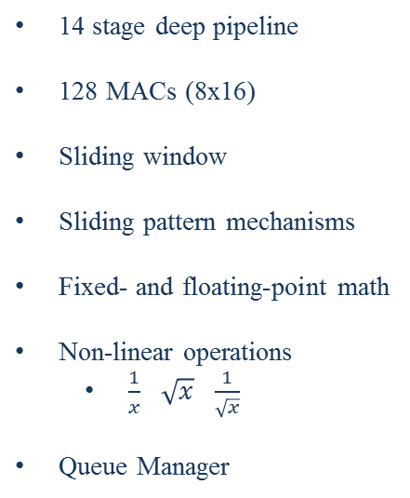
CevaXM4 - Configuration
Name | Config | Name | Config
AXI_masters_num | 2 ( EDP EPP ) | amba_ecc | off
AXIM_width | 128 bit
AXI_slave_num | 1 ( EDAP ) | non_linear_units | 32
AXIS_width | 128 bit | qman_num | 8
DTCM_size | 128KB | sflp | 4
PTCM_size | 32KB | spu_xtend | off
PCACHE_size | 32KB | vflp | 16
 |  | vpu_xtend | off
mem_power_gating | off
memory_ecc | off | real_time_trace | off
14 stage deep pipeline
128 MACs (8x16)
Sliding window
Sliding pattern mechanisms
Fixed- and floating-point math
Non-linear operations
$\frac{1}{x}$ $\sqrt{x}$ $\frac{1}{\sqrt{x}}$
Queue Manager

Slide 5




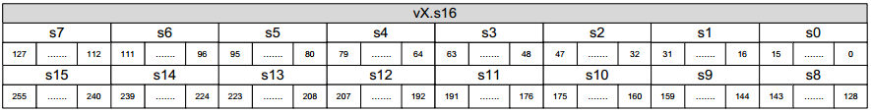
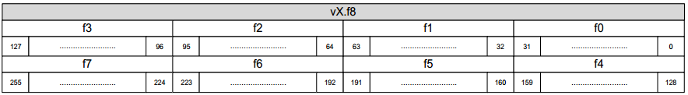
CevaXM4 – Register File
General Register File (GRF)
Num: 32
Width: 32 bits
Vector Register File (VRF)
Num: 40
Widht: 256 bits
① v0-v31 general purpose
(8xint, 16xshort, 32xchar, 8xfloat)
② v24-v39 accumulator
Predicate Register File (PRF)
Address Register File (ARF)
System/Sequencer Register File (SRF)

Slide 6
CevaXM4 – Boot
Reset | Description
ceva_global_rst_n | Asynchronous reset for the whole DSP (core, MSS, PSU, OCEM )
ceva_sys_rst_n | Asynchronous reset for the Core and MSS
ceva_core_rst_n | Asynchronous reset for only core
ceva_ocem_rst_n | Asynchronous reset for OCEM
input port:
[0:0] boot
[31:0] vector
From Address 0 |  | From External Address
boot = 0 |  | boot = 1
vector = x |  | vector = address
DMA | AXI Slave | EPP | Cache

Slide 7
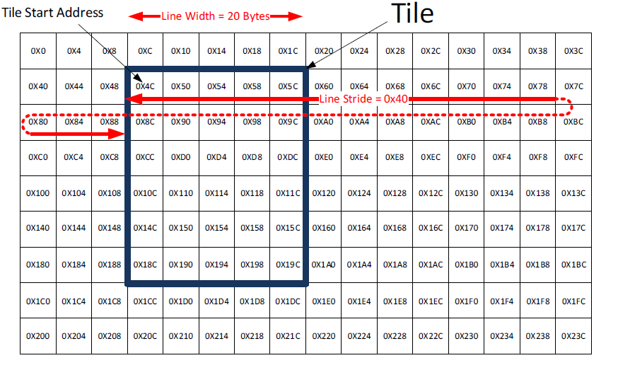
CevaXM4 – DMA and QMAN
Transfer Type
Message
Linear
2-dimensional
One-bank/Two-bank Tile
Duplicate Bank Transfer
DTCM
Direction
DTCM to DTCM
DTCM to External Memory
External Memory to DTCM

Slide 8
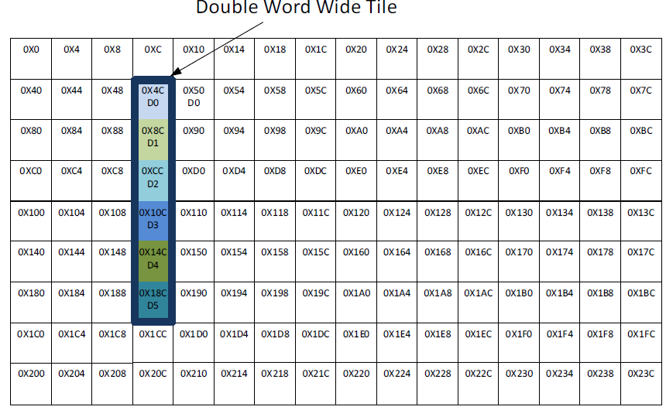
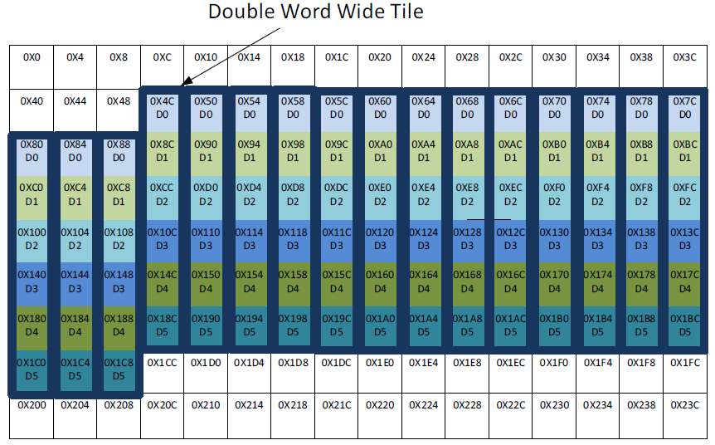
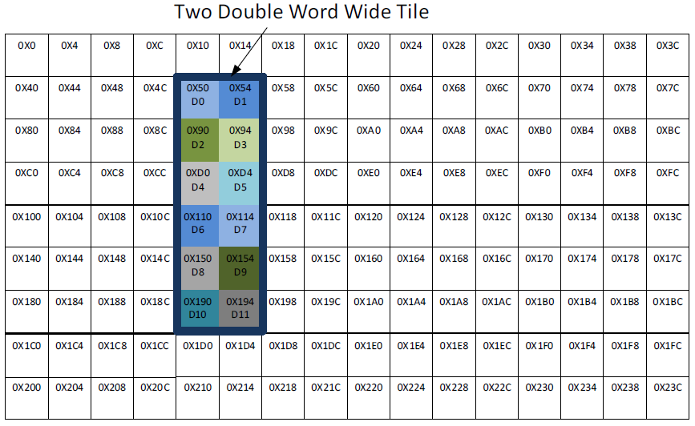
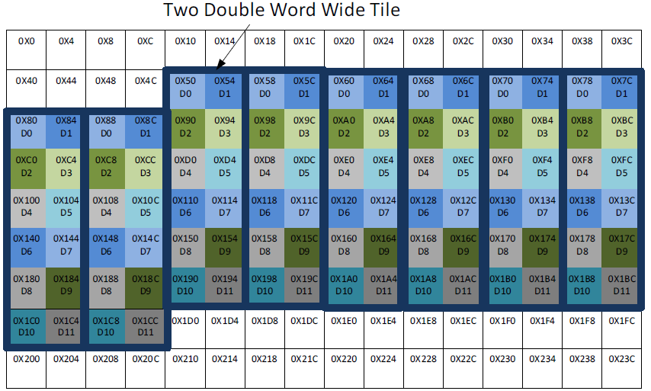
CevaXM4 – DMA and QMAN

Slide 9
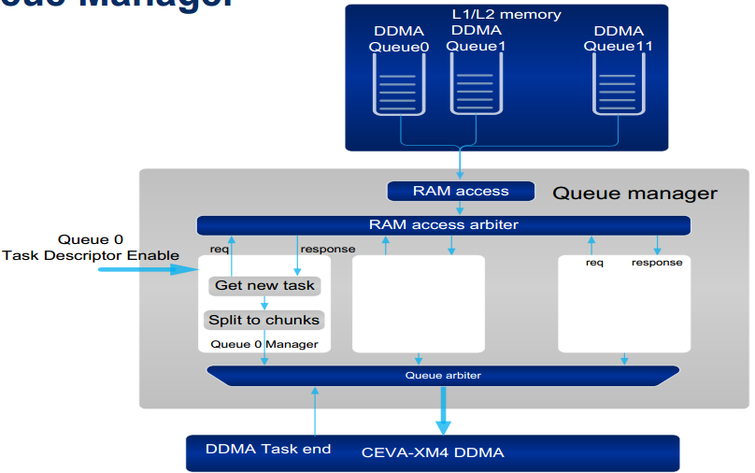
CevaXM4 – DMA and QMAN

Slide 10
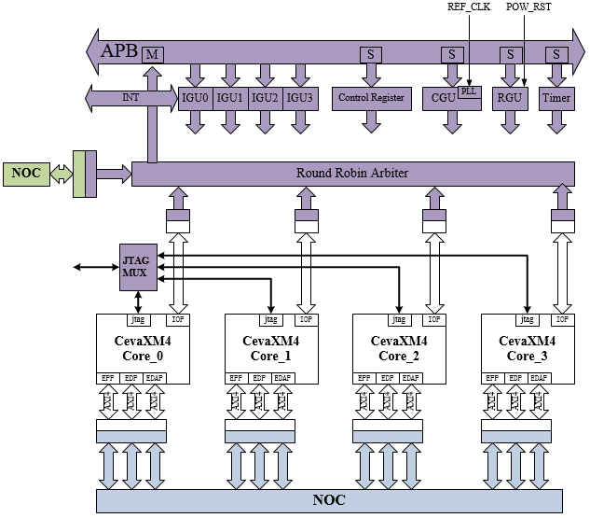
CevaXM4_Subsys – Block Diagram

Slide 11
CevaXM4_Subsys – RGU/CGU/Reg
RGU
MODULE | RESET | Description
APB | apb_rstn | software reset. auto released
cevaxm4_core0 | global_rstn sys_rstn core_rstn ocem_rstn | software reset
cevaxm4_core1 | global_rstn sys_rstn core_rstn ocem_rstn | software reset
cevaxm4_core2 | global_rstn sys_rstn core_rstn ocem_rstn | software reset
cevaxm4_core3 | global_rstn sys_rstn core_rstn ocem_rstn | software reset
CGU
Reg

Slide 12
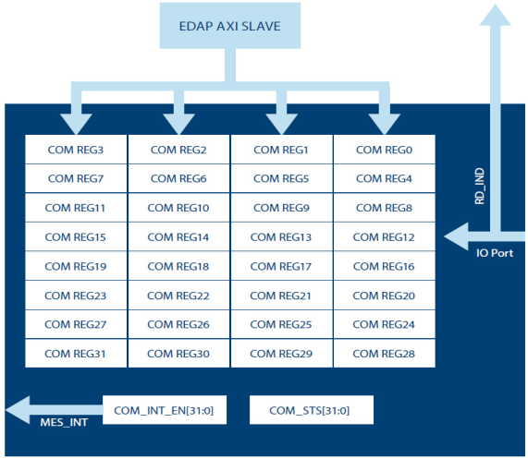
CevaXM4_Subsys – IGU/Multi-core
CGU
MCCI

Slide 13
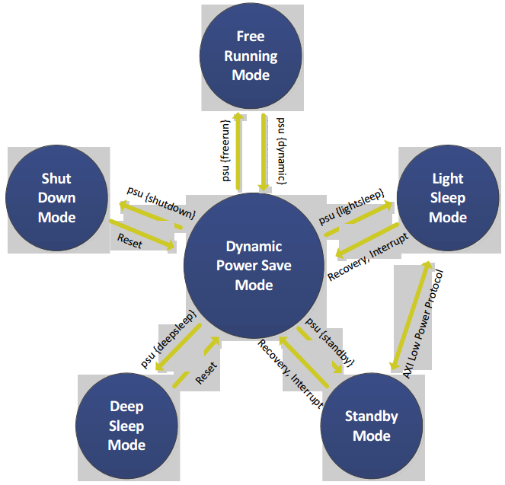
CevaXM4_Subsys – MV Design
PD0
PD1
PD2
PD3
OD

Slide 14
Thank you !
Q & A

